Slide 1

X Education: Lead Scoring Analysis
Todd Ryman and Rajat Patil

Slide 2

About X Education
X Education sells online course to industry professional. The company uses search engines and social media to market their courses.
Objective of the Analysis
X Education currently gets lots of leads and all leads are contacted but it’s we found in the data provided the current conversion rate is only 38%. This means the sales team are currently wasting effort on 62% of leads they contact. X education would like to find a model that will provide a conversion rate of target of approx. 80%

Slide 3
Steps taken in this Analysis
Imported the data set provided by X Education
Analyze this dataset and decided to run a logistical regression analysis on the data as we need to be able to make predictions.
Cleaned the data by removing the columns with large null values
Removed data that was highly correlated
Prepared the data for regression model analysis
Ran multiple regression models to find the right variables that had the greatest effect whilst keeping the accuracy above 80%
Tested out final model against the test data to ensure the model produce the designed outcomes.
Analyzed the results to formulate our recommendations which are offered in this presentation.

Slide 4

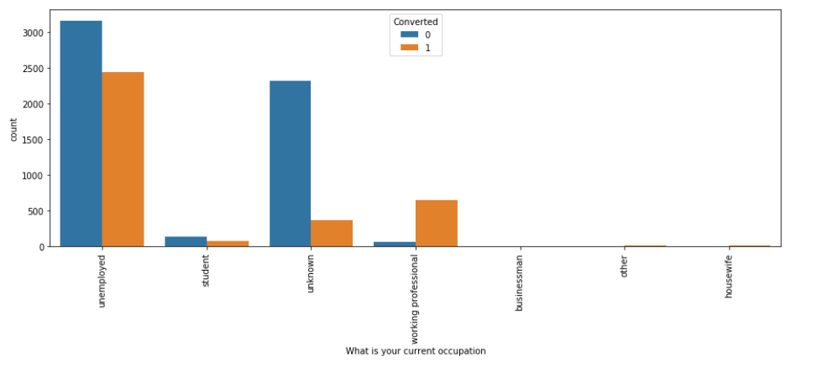
Initial Data Analysis – Current Occupation
The graph above outlines the high proportion of conversion for working professional inferring this will be a key variable in our dataset

Slide 5
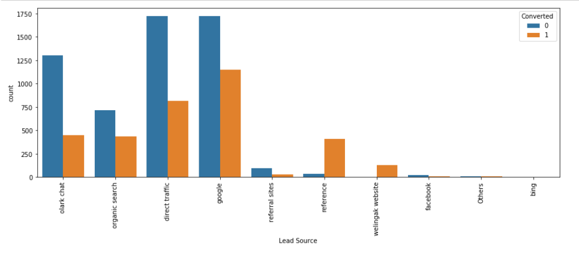
Initial Data Analysis – Lead Source
The graph above outlines the high proportion of conversion for reference and welligak website inferring these will be a key variables in our dataset

Slide 6
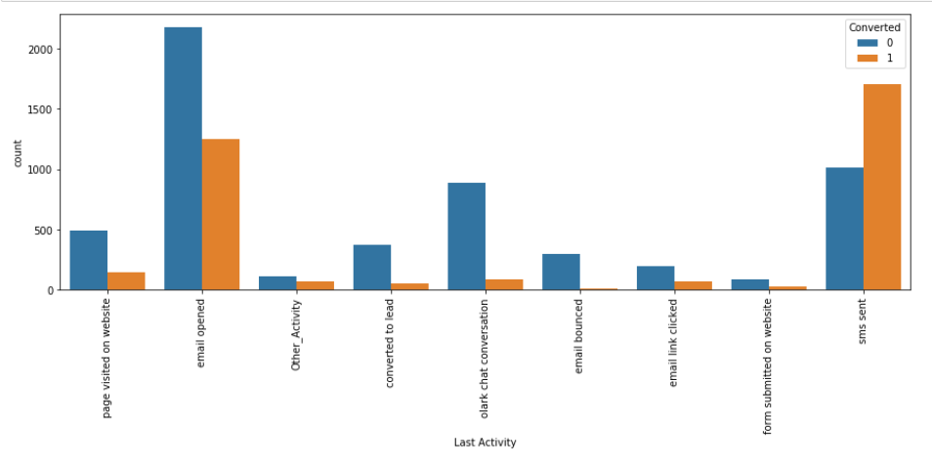
Initial Data Analysis – Last Activity
The graph above outline the high proportion of conversion for SMS sent and approx. 50 % conversion on email opened

Slide 7
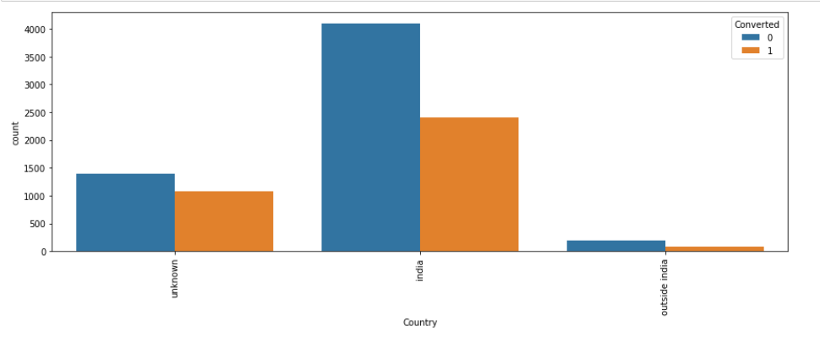
Initial Data Analysis – Country
The graph above outline the similar spread of conversions with Unknown having a slightly better conversion. As Unknown is like a null value this indicates that it does really seem to matter which country the lead comes from.

Slide 8
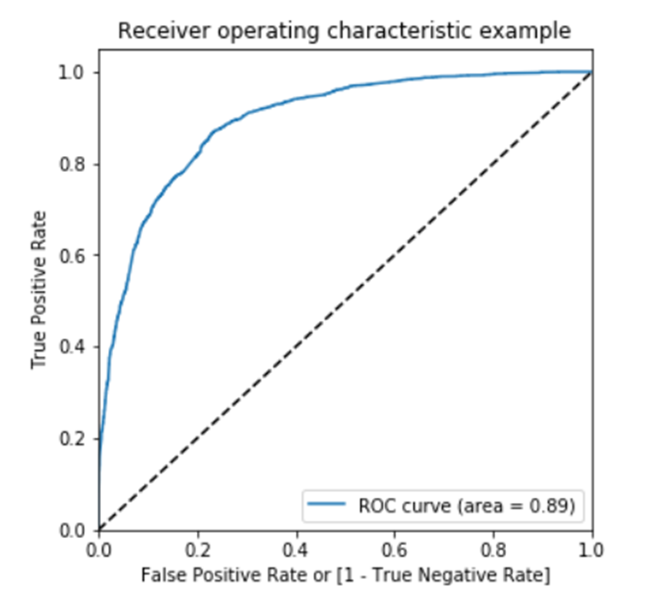
Model Building
We split the dataset into train and test data, then started building and refining our model on the train set of data.
We apply feature scaling of the continuous variables using the Standard Scaler method.
We use recursive feature elimination to extract the 20 most important variables from the dataset.
Checking the all the variables p-values (to see if the variable is statistically significant or not ) and Variable Inflation Factor (to see if the variables are dependent or not.) This allowed us to reduce the number of variables to 16 whilst still get similar accuracy score to the whole dataset.
Using the ROC to the left we can see we have a excellent result for our model of 0.89.
Checking the model for sensitivity , specificity and accuracy we where satisfied we had a solid model to more forward with
We then ran the model against the test data and evaluated the results.

Slide 9
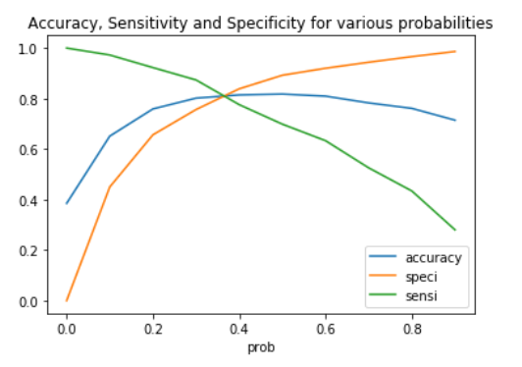
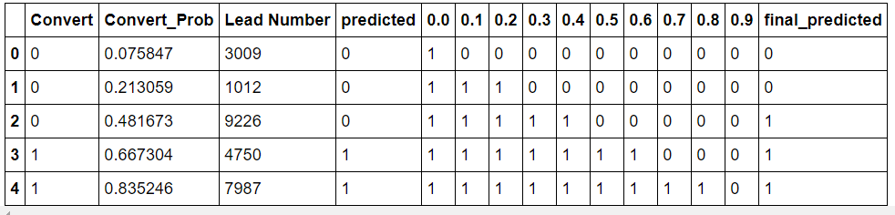
Probability Cutoff
We used the probability cut-ff curves to the right and table below to determine the appropriate cutoff point for our model. The ideal point was at 0.35 which still gave us 80% accuracy as requested by X education.

Slide 10
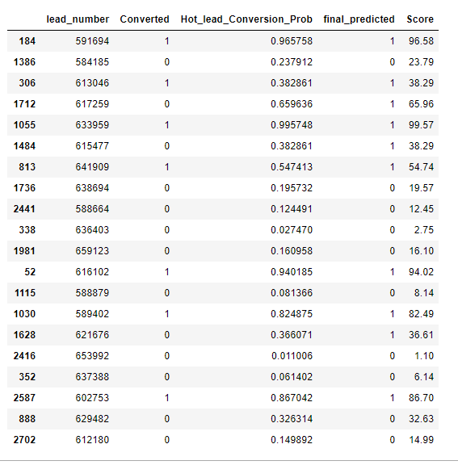
Random Sample of Data
The table to the right is a random sample (20) of the dataset.
The sample has the final score added on the last column. Any score over 35 results in a predicted conversion. In the sample the overall result is our model correctly predicted 17 out of 20 results which is 85%
Of particular interest are the results highlighted in green and red. The red highlighted items are the results the model predicted incorrectly. Two of these results are on the edge of the cutoff score of 35.
The green results show two other results around the 35 cutoff score that were predicted correctly

Slide 11
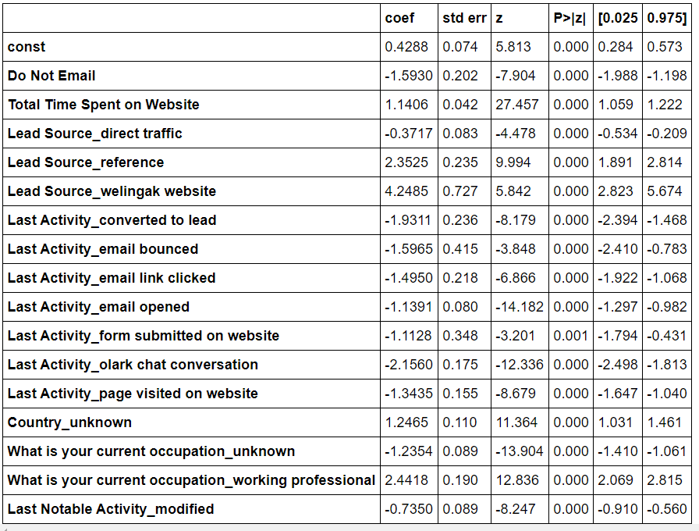
Final Model Variables
The table to the right shows the final 16 variables (ignore const) we used to build our model. The major positive influences on the model were:
Total Time Spent On Website
Lead Source_reference
Lead Source_welingbak wedsite
Country_unknown
What is your current occupation_working professional

Slide 12

Recommendations
We recommend X education adopt our model to increase the probability of converting a lead to a student
Our model will allow X education to increase their current conversion rate from approx. 38% up to approx. 80%
The model can also be adjusted by changing the cutoff score higher or lower depending on the business requirements
When more sales staff are available X education could use a lower score to achieve a greater number of conversion albeit with greater percentage of non-conversion
When sales staff are busy the score can be increased to ensure a greater percentage of lead conversions
The main leads to target are working professionals, people who spend a longer amount of time on the website and direct referrals.

Slide 13

Thank You!
Prepared by Todd Ryman and Rajat Patil

